Slide 1

Despec Computer Inc.
2014 2nd Quarter – Financial & Operational Results
Analyst Presentation
11 August 2014
İstanbul

Slide 2
Disclaimer
This presentation contains information and analysis on financial statements as well as forward-looking statements that reflect the Company management’s current views with respect to certain future events. Although it is believed that the information and analysis are correct and expectations reflected in these statements are reasonable, they may be affected by a variety of variables and changes in underlying assumptions that could cause actual results to differ materially.
Neither Index Computer nor any of its managers or employees nor any other person shall have any liability whatsoever for any loss arising from the use of this presentation.

Slide 3
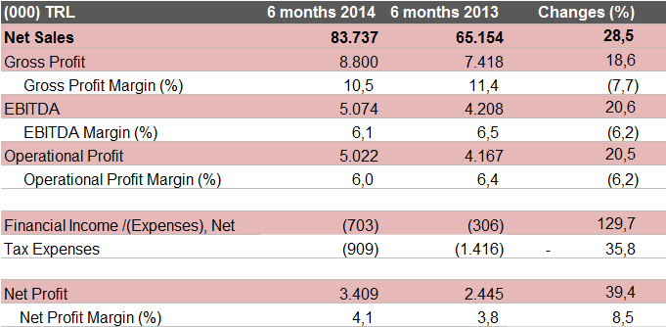
Summarized P/L Account- 1H 2014 (000 TRL)

Slide 4
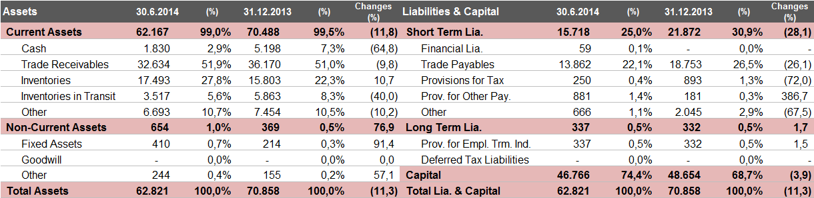

Summarized Balance Sheet (000 TRL)

Slide 5
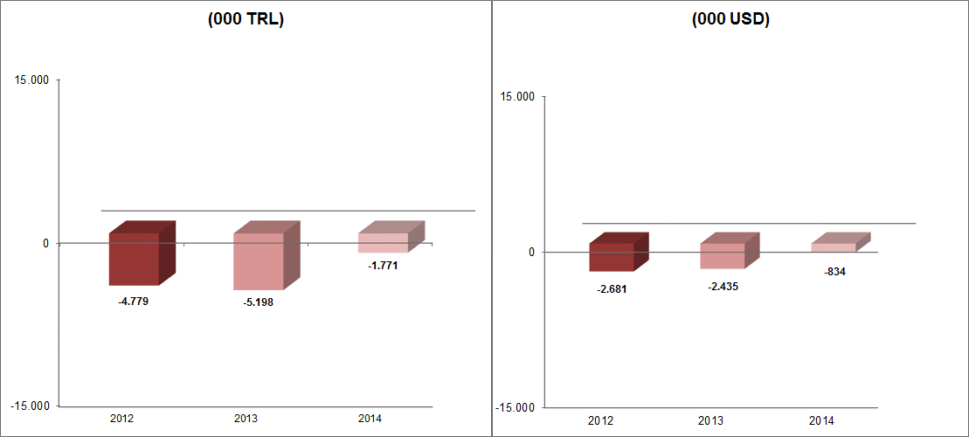
Net Financial Debt (000 TRL & USD)

Slide 6
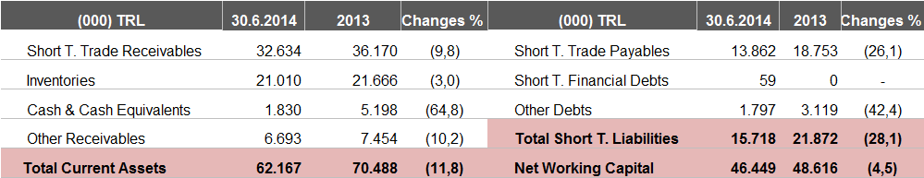
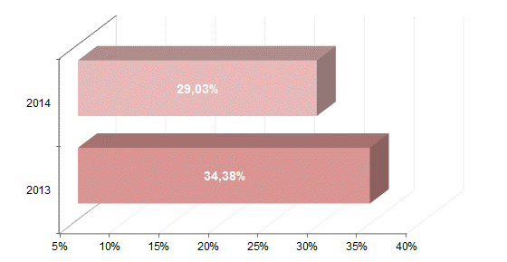
Working Capital (000 TRL)
Working Capital / Net Sales

Slide 7
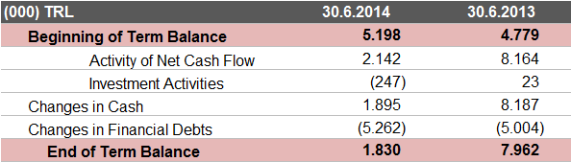
Cash Flow (000 TRL)

Slide 8
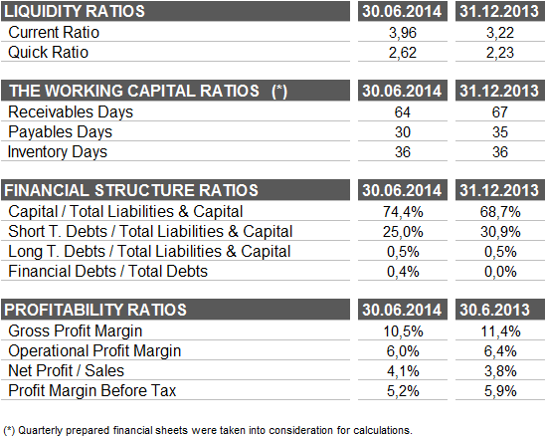
Financial Ratios

Slide 9


Thanks...
Think About the Environment!

